Slide 1
Programming
Structures

Slide 2
Structures
A Structure is a collection of related data items, possibly of different types.
A structure type in C++ is called struct.
A struct is heterogeneous in that it can be composed of data of different types.
In contrast, array is homogeneous since it can contain only data of the same type.

Slide 3
Structures
Structures hold data that belong together.
Examples:
  Student struct: student id, name, major, gender, start year, …
  Bank struct: account number, name, currency, balance, …
  Address struct: name, address, telephone number, …

Slide 4
Structures
Individual components of a struct type are called members (or fields).
Members can be of different types (simple, array or even struct).
Variables of type struct are created to store data in it. Even an array of struct variables can be initialized.

Slide 5
struct basics
Definition of a structure:
struct <struct-type>{
<type> <identifier_list>;
<type> <identifier_list>;
...
} ;
Example:
struct Date {
int day;
int month;
int year;
} ;
Each identifier
defines a member
of the structure.
The “Date” structure
has 3 members,
day, month & year.

Slide 6
struct examples
Example:
struct StudentInfo{
int Id;
int age;
char Gender;
double CGA;
};
Example:
struct StudentGrade{
char Name[15];
char Course[9];
int Lab[5];
int Homework[3];
int Exam[2];
};
The “StudentInfo”
structure has 4 members
of different types.
The “StudentGrade”
structure has 5
members of
different array types.

Slide 7
struct examples
Example:
struct BankAccount{
char Name[15];
int AcountNo[10];
double balance;
Date Birthday;
};
Example:
struct StudentRecord{
char Name[15];
int Id;
char Dept[5];
char Gender;
};
The “BankAcount”
structure has simple,
array and structure
types as members.
The “StudentRecord”
structure has 4
members.

Slide 8
struct basics
Declaration of a variable of struct type:
<struct-type> <identifier_list>;
Example:
StudentRecord Student1, Student2;
Student1 and Student2 are variables of StudentRecord type.
Name
Id Gender
Dept
Name
Id Gender
Dept
Student1
Student2

Slide 9
Ex. 1: struct basics
The members of a struct type variable are accessed with the dot (.) operator:
<struct-variable>.<member_name>;
Example:
strcpy(Student1.Name, "Chan Tai Man");
Student1.Id = 12345;
strcpy(Student1.Dept, "COMP");
Student1.gender = 'M';
cout << "The student is ";
switch (Student1.gender){
case 'F': cout << "Ms. "; break;
case 'M': cout << "Mr. "; break;
}
cout << Student1.Name << endl;
Student1
Name
Id Gender
Dept
Chan Tai Man
12345 M
COMP

Slide 10
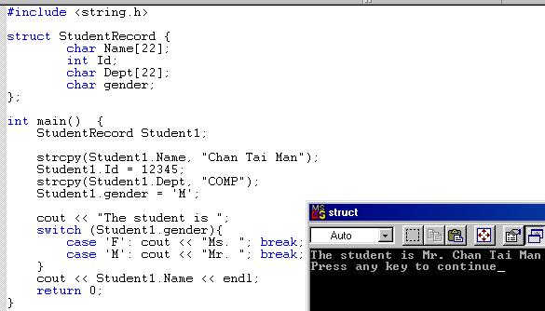

Slide 11
Ex. 2: struct-to-struct assignment
The values contained in one struct type variable can be assigned to another variable of the same struct type.
Example:
strcpy(Student1.Name,
"Chan Tai Man");
Student1.Id = 12345;
strcpy(Student1.Dept, "COMP");
Student1.gender = 'M';
Student2 = Student1;
Student1
Chan Tai Man
12345 M
COMP
Chan Tai Man
12345 M
COMP
Student2

Slide 12
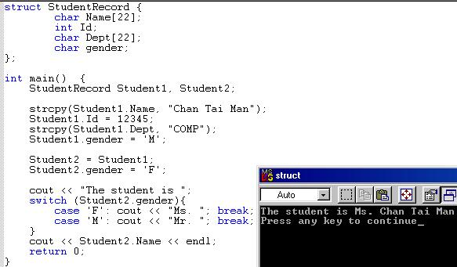

Slide 13
Ex. 3-5: Nested structures
We can nest structures inside structures.
Examples:
struct point{
double x, y;
};
point P;
struct line{
point p1, p2;
};
line L;
struct triangle{
point p1, p2, p3;
};
triangle T;
(P.x, P.y)
(L.p2.x, L.p2.y)
(L.p1.x, L.p1.y)
(T.p2.x, T.p2.y)
(T.p3.x, T.p3.y)
(T.p1.x, T.p1.y)

Slide 14
Ex. 3-5: Nested structures
We can nest structures inside structures.
struct line{
point p1, p2;
};
line L;
(L.p2.x, L.p2.y)
(L.p1.x, L.p1.y)
line
p1 p2
x y x y

Slide 15
Ex. 3-5: Nested structures
Assign values to the variables P, L, and T using the picture:
point P;
line L;
triangle T;
(4, 11)
(10, 9)
(2, 7)
(6, 5)
Ex. 3: Graph a point
Ex. 4: Graph a line
Ex. 5: Graph a triangle
(8, 3)
(2, 0)

Slide 16
Ex. 3-5: Nested structures
point P;
line L;
triangle T;
P.x = 4;
P.y = 11;
(4, 11)
(10, 9)
L.p1.x = 2;
L.p1.y = 7;
L.p2.x = 10;
L.p2.y = 9;
(2, 7)
(6, 5)
T.p1.x = 2;
T.p1.y = 0;
T.p2.x = 6;
T.p2.y = 5;
T.p3.x = 8;
T.p3.y = 3;
(8, 3)
(2, 0)

Slide 17
Arrays of structures
An ordinary array: One type of data
An array of structs: Multiple types of data in each array element.
0 1 2 … 98 99
0 1 2 … 98 99

Slide 18
Arrays of structures
We often use arrays of structures.
Example:
StudentRecord Class[100];
strcpy(Class[98].Name, "Chan Tai Man");
Class[98].Id = 12345;
strcpy(Class[98].Dept, "COMP");
Class[98].gender = 'M';
Class[0] = Class[98];
Chan Tai Man
12345 M
COMP
. . .
0 1 2 … 98 99

Slide 19
Arrays inside structures
We can use arrays inside structures.
Example:
struct square{
point vertex[4];
};
square Sq;
Assign values to Sq using the given square
(4, 3)
(10, 3)
(4, 1)
(10, 1)
x y
x y
x y
x y

Slide 20
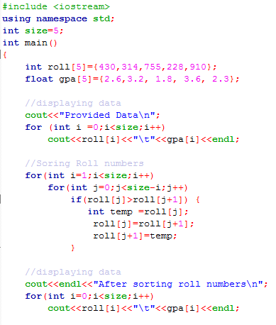
Example: Storing Student’s data in multiple arrays

Slide 21
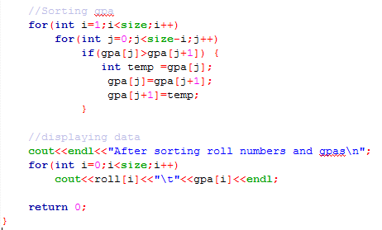
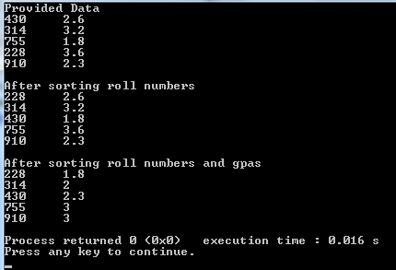
Output →

Slide 22
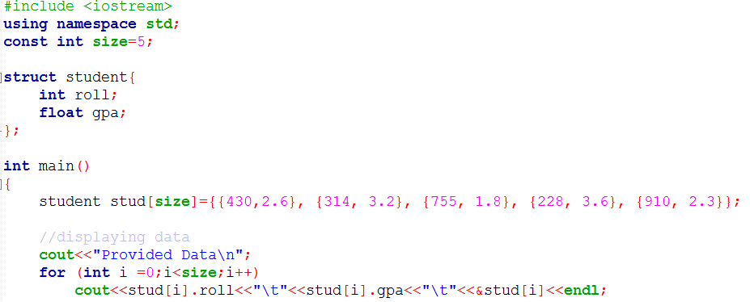
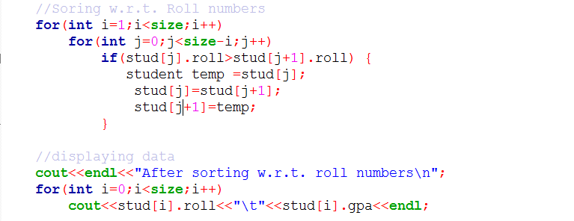
Example: Sorting Student’s data in a structure array

Slide 23
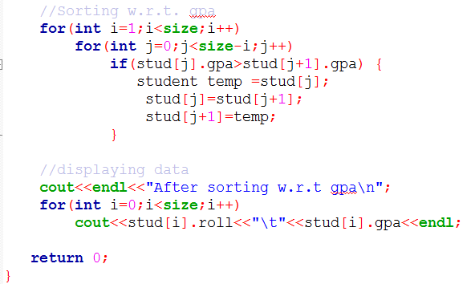
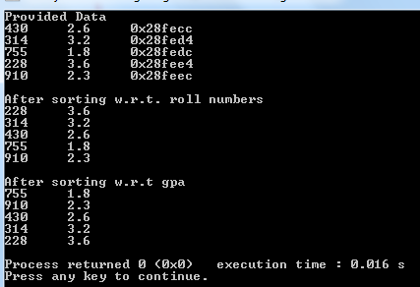
Output →

